Slide 1
Robot Framework Introduction

Slide 2
Why Automate?

Slide 3
Requirements
Testing
How the System should behave
How the System should behave
Documentation
Documentation
SRS
Test Plan
3

Slide 4

User Story / Feature
Acceptance Criteria
executable
feedback

Slide 5
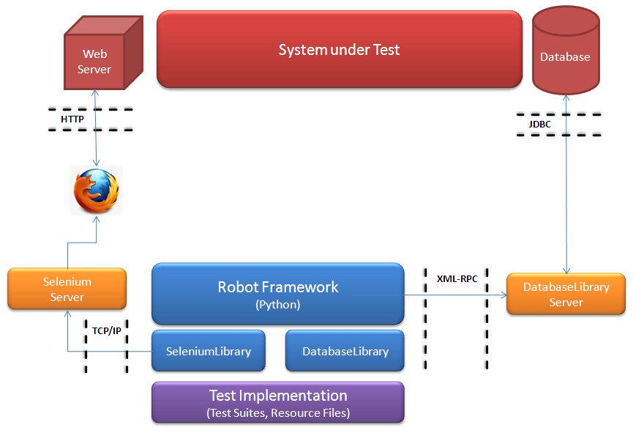
Testing Architecture

Slide 6
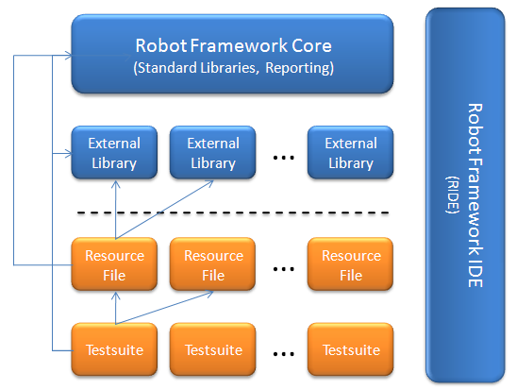
Robot Framework Overview

Slide 7
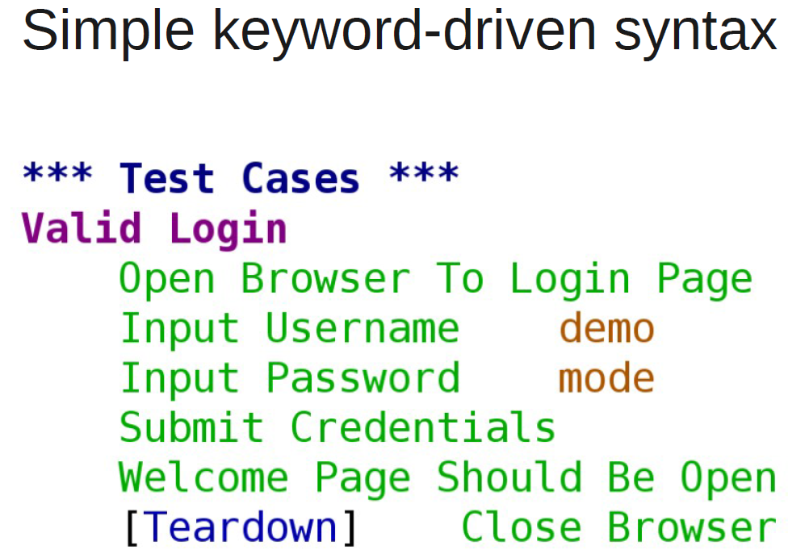

Slide 8
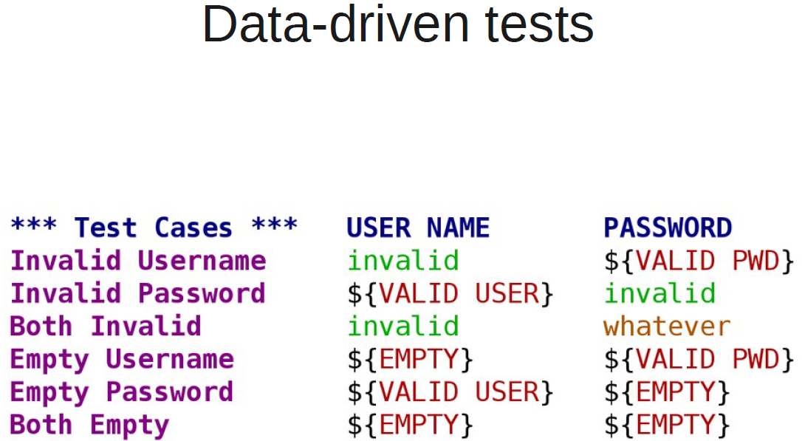

Slide 9
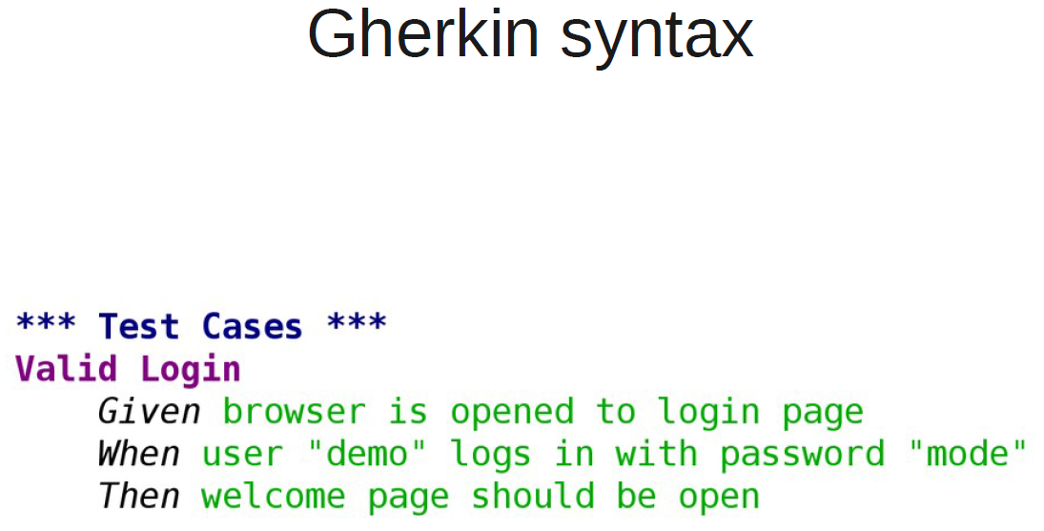

Slide 10
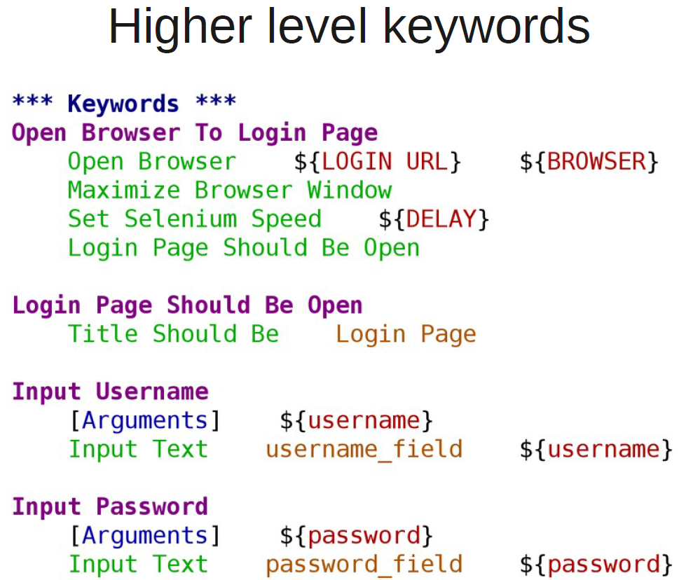

Slide 11
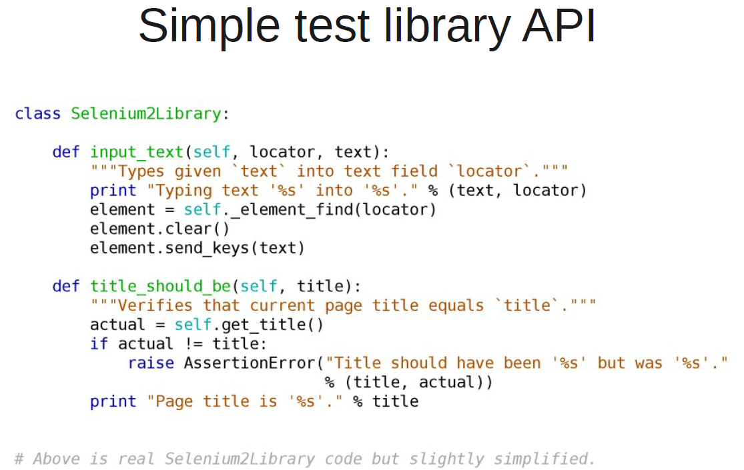

Slide 12
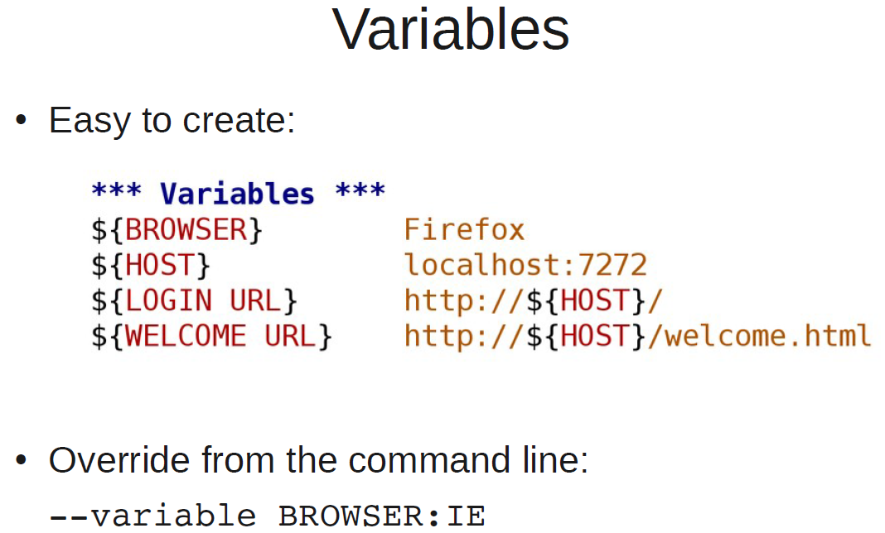

Slide 13
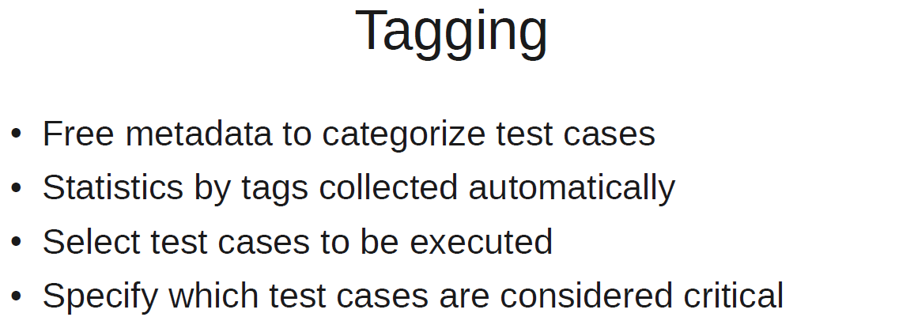

Slide 14
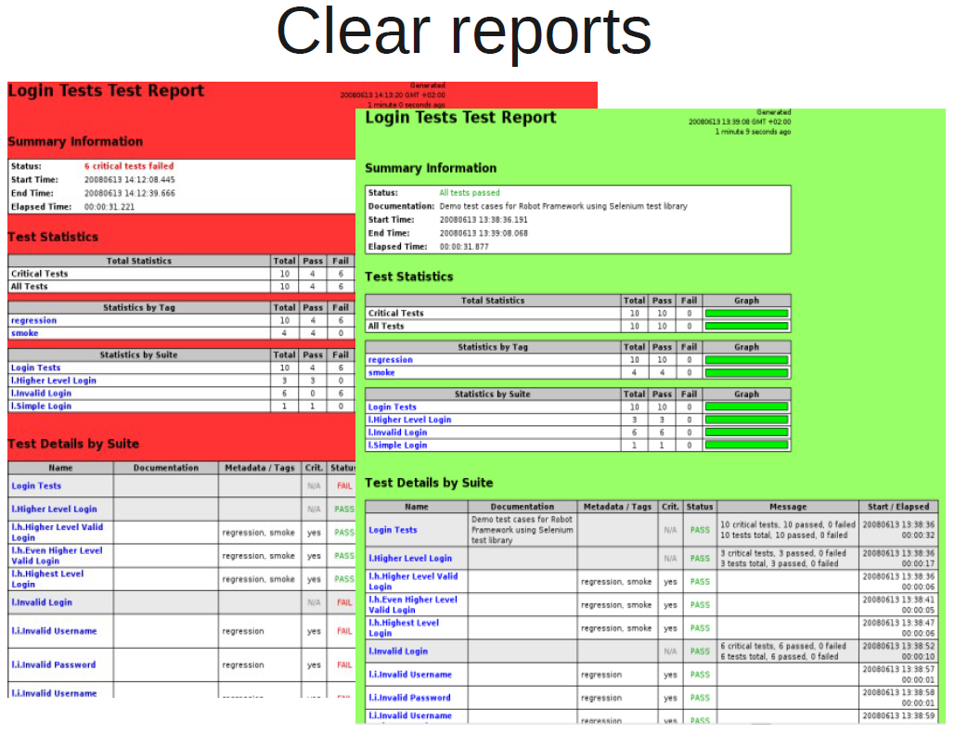

Slide 15
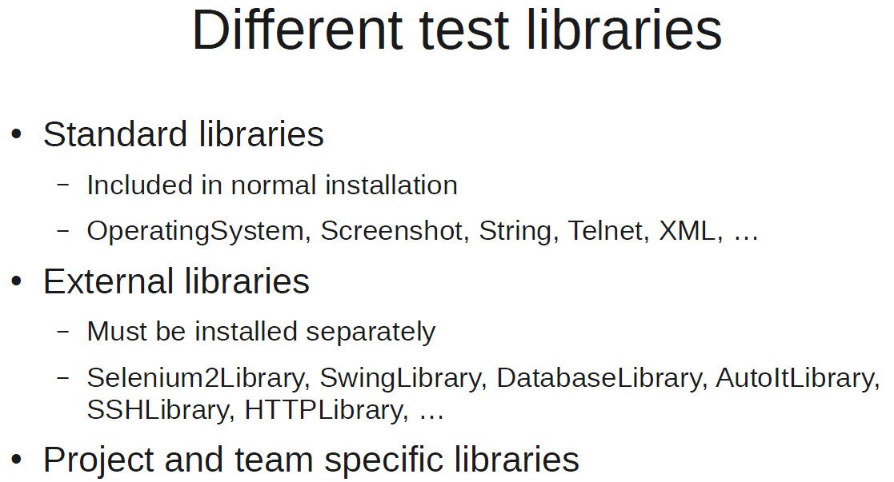

Slide 16
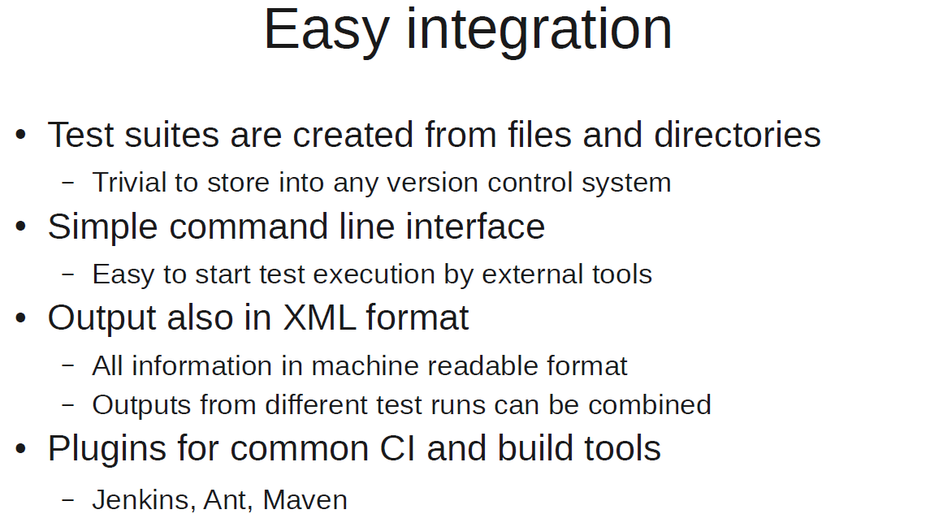

Slide 17
